Slide 1
DATA ANALYTICS AIRLINE DATA ANALYTICS FOR AVIATION INDUSTRY

Slide 2
TEAM MEMBERS:
SINEKA.V
VINOTHINI.P
SRUTHI.R
THARANI.E

Slide 3
SPRINT 1

Slide 4
PROJECT DEVELOPMENT PHASE
SPRINT 1
COLLECTING THE DATA
UPOADING THE DATA
PREPARING THE DATA
SPRINT 2
EXPLORATION OF DATA
PRESENTATION OF DATA
SPRINT 3
CREATING INTERATIVE DASHBOARD WITH EXCLUSIVE GRAPHICAL REPRESENTATION
SPRINT 4
REPORT CREATION AND STORY CREATION

Slide 5
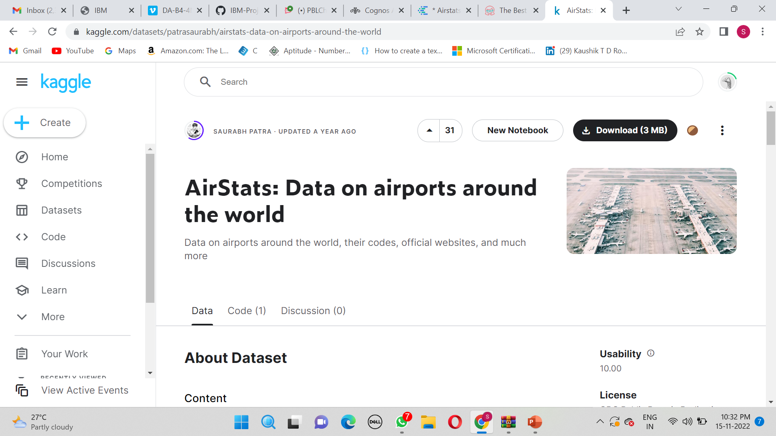
1.COLLECTING THE DATA
DATA SET LINK:https://www.kaggle.com/datasets/patrasaurabh/airstats-data-on-airports-around-the-world

Slide 6
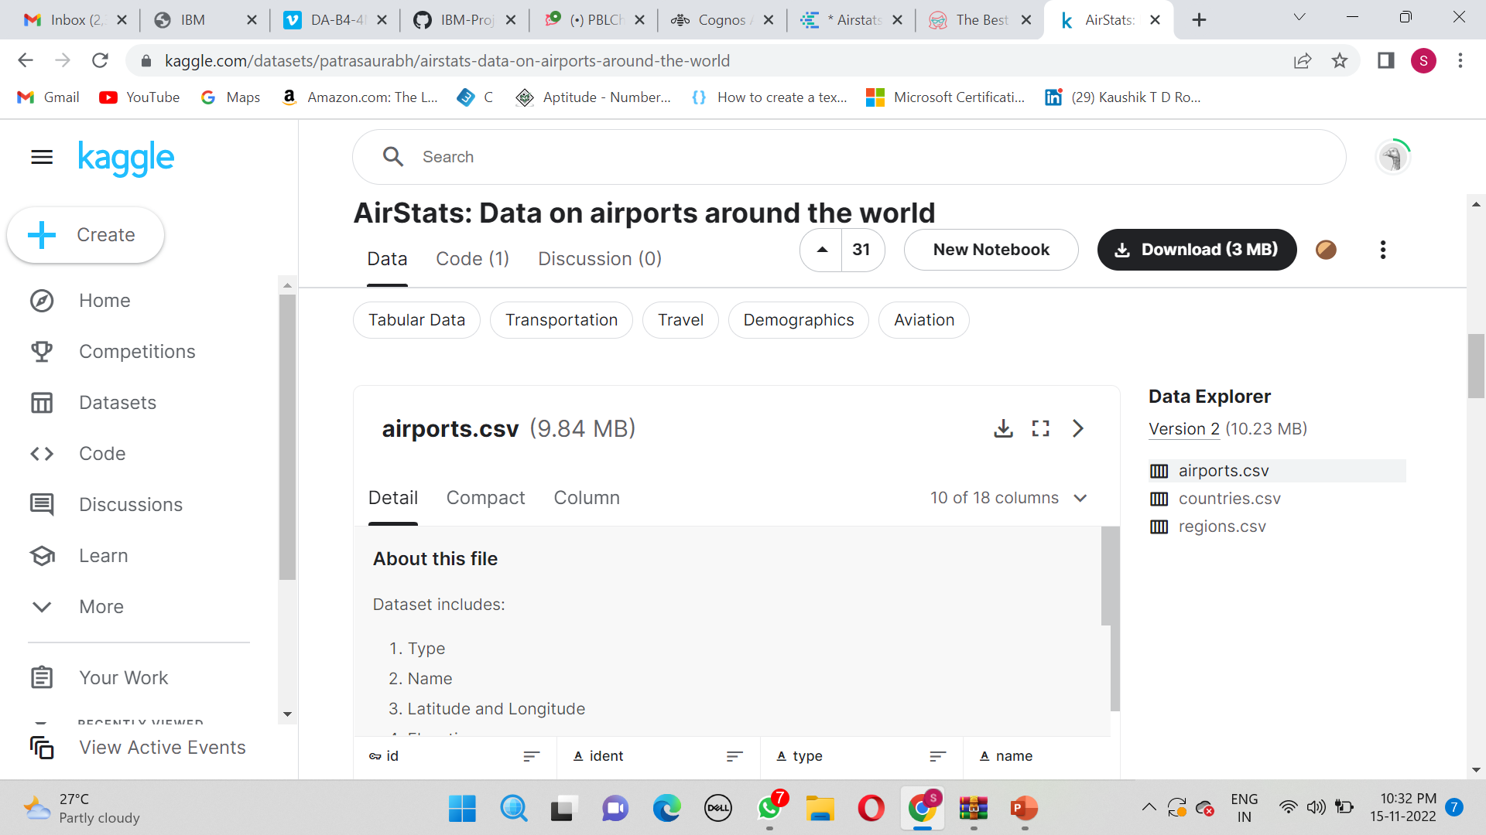

Slide 7
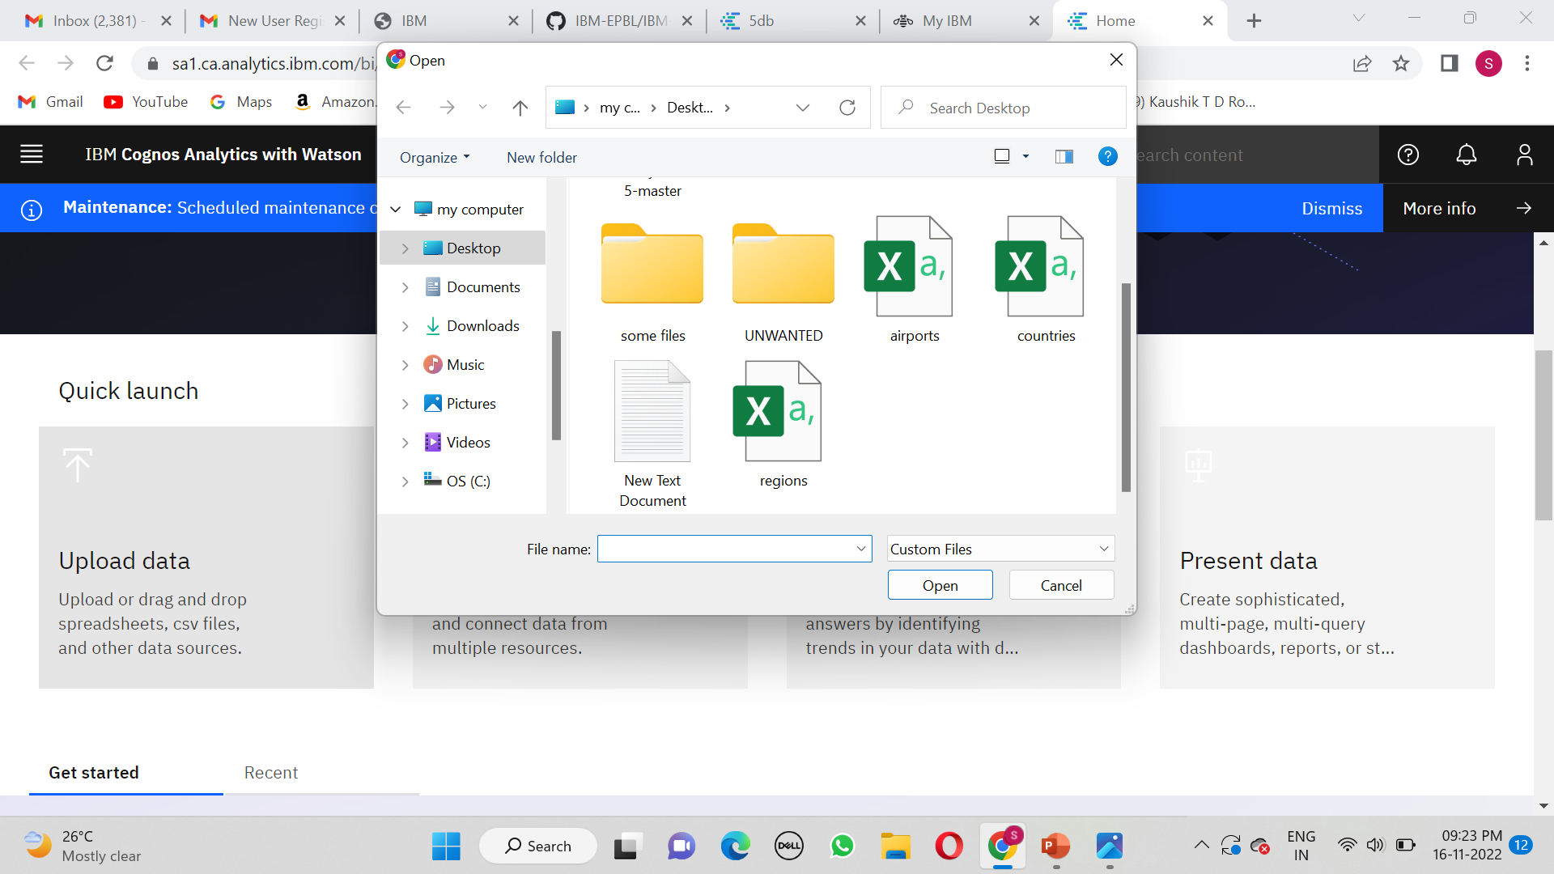
2.UPLOADING THE DATA SET

Slide 8
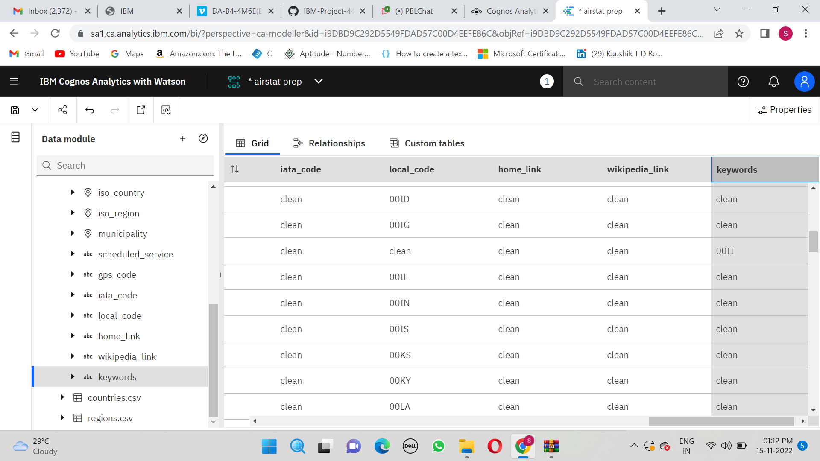
3.PREPARE DATA
CLEAR NULL VALUES:

Slide 9
THANK YOU

